Slide 1
TSP- AI ML Fundamentals (Capstone Project)
SENTIMENT ANALYSIS AI SYSTEM
Presented By:
VIJAYA SAKTHI KUMAR S – au91762112105 Alagappa chettiar government college of engineering and technology.
Guided By:

Slide 2
OUTLINE
Problem Statement (Should not include solution)
Proposed System/Solution
Algorithm & Deployment
GitHub Link
Project Demo(photos / videos)
Conclusion
Future Scope
References

Slide 3
Problem Statement
Sentiment analysis AI System
Sentiment analysis of movie reviews aims to automatically classify opinions expressed in textual reviews as positive, negative, or neutral to gauge audience reactions and inform decision- making in the film industry.

Slide 4
Proposed Solution
The proposed Python solution employs the VADER sentiment analysis tool to categorize movie reviews as positive, negative, or neutral. It involves importing libraries, loading the dataset, initializing VADER, calculating sentiment scores, categorizing them, and finally, printing the results. This Python-based approach offers a concise and effective means of analyzing sentiment in movie reviews.

Slide 5
Algorithm & Deployment
Import Libraries: Import necessary Python libraries including pandas and NLTK's VADER sentiment analyzer.
Download VADER Lexicon: Use NLTK to download the VADER lexicon.
Load Dataset: Read movie review dataset into a pandas DataFrame.
Initialize Sentiment Analyzer: Initialize VADER sentiment analyzer.
Calculate Sentiment Score: Define function to calculate sentiment score for each review.
Add Score Column: Apply sentiment score function to each review and add new column to DataFrame.
Categorize Sentiment: Define function to categorize sentiment scores.
Add Category Column: Apply sentiment category function to each score and add new column to DataFrame.
Print Results: Print summary of sentiment analysis results.

Slide 6
GitHub Link
https://github.com/vjvsk7/Naan-mudhalvan-project-au91762112105

Slide 7
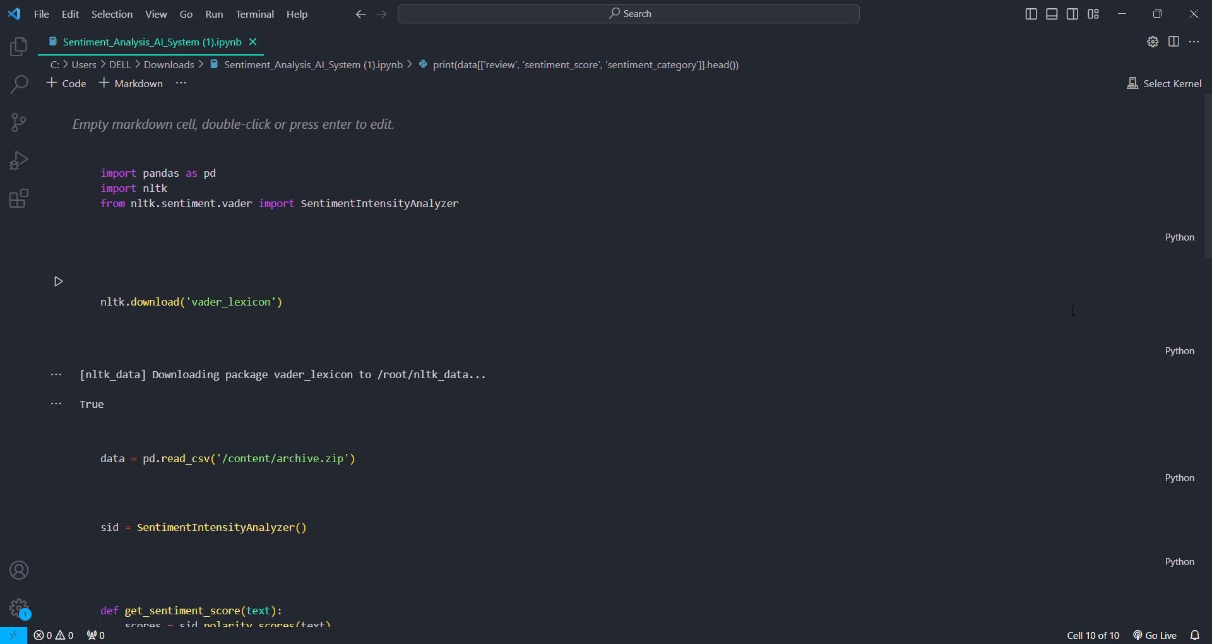
Project Demo(Recorded Video)

Slide 8
Conclusion
In conclusion, the sentiment analysis of movie reviews using VADER in Python offers a straightforward yet powerful approach to understanding audience opinions. By leveraging natural language processing techniques, we can automatically categorize reviews as positive, negative, or neutral, providing valuable insights for filmmakers, producers, and movie enthusiasts alike. The deployment of this solution enables real-time analysis of movie sentiment, facilitating informed decision-making and enhancing the overall movie-watching experience. With its ease of implementation and scalability, this project underscores the significance of leveraging data-driven approaches to gain actionable insights from textual data.

Slide 9
Future Scope
The future scope of the sentiment analysis of movie reviews project includes:
1.Enhancing sentiment analysis accuracy. 2.Supporting multiple languages.
Exploring aspect-based sentiment analysis.
Developing real-time analysis capabilities.
Integrating with recommendation systems. 6.Creating sentiment visualization tools.
7.Expanding analysis to social media platforms. 8.Analyzing historical sentiment trends.

Slide 10
References
Dataset is provided by Kaggle
https://www.kaggle.com/datasets/lakshmi25npathi/imdb-dataset-of-50k- movie-reviews?resource=download
Title: "Deep Learning for Sentiment Analysis: A Survey"
Authors: Lei Zhang, Shuai Wang, and Bing Liu
Journal/Conference: IEEE Transactions on Knowledge and Data Engineering

Slide 11
THANK YOU

